Slide 1

About Us . . . .
United Contracting Works Pvt. Ltd. is a Private Limited Company established in 2015 (Subsidiary of M/s United Engineering work with Proprietor Mr. Afzal Hasan).
The firm undertakes Projects of Plumbing & Fire Fighting Works at Pan India.
The Company was founded by Mr. Afzal Hasan in 1996 in the name of United Engineering Works
The Director of the Company Afzal Hasan is a Mechanical Engineer who has 28 years of experience in the field of Projects of Plumbing & Fire Fighting Works.

Slide 2
The company has an executive management team of highly qualified and experience professionals who have hands on experience in managing big and prestigious projects.
Sound technical expertise, Quality Workmanship, Commitment to Work Ethics and promised deliverance of Works along with a strong financials has enabled us to attract and retain our Clients over the past many years.
We have a team of qualified, seasoned staff (most of them are with us for over 10-20 years) who adhere to the best industry practices of workmanship and transform the customers dream into reality by their quality & timely deliverance of the project.
Major Clients- DLF, M3M India Pvt. Ltd., Pioneer Urban Infrastructure Pvt Ltd, Brookfield, Elan, Paras, Spaze, Vipul, Reach, AMB Group, Mankind Pharma, IHG, Gail Ltd, Mapsko, BPTP Ltd, Unitech, Smart World

Slide 3
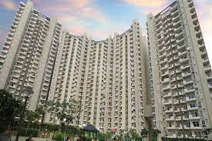
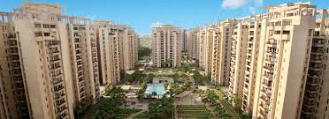
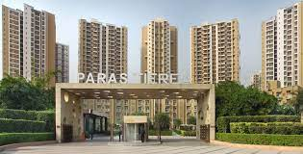
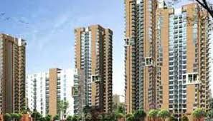
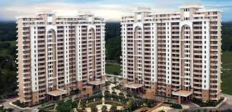
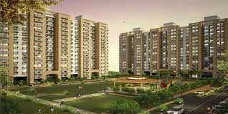

Our Proud Achievements
Major Residential Sector
Mount Villa, Gurgaon
Orchid Patels, Gurgaon
Paras Tereia, Noida
Vipul Balmonte, Gurgaon
Vipul Lawania, Gurgaon
M3M Trump Tower
Smart world Gems
Pioneer Araya
Pioneer Presidia
DLF Garden Valley

Slide 4

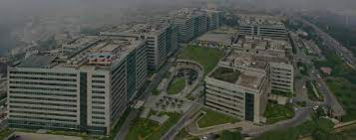
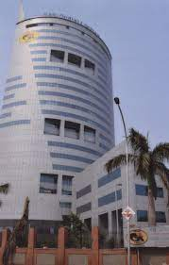
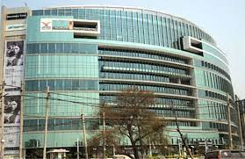


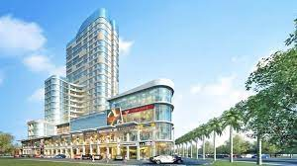
Our Proud Achievements Major Commercial Sector
Brookfield Noida
Brookfield Gurgaon
Gail Jublee, Noida
Spaze IT Park, Gurgaon
M3M Uraban IT Park
M3M IFC, Gurgaon.
ELAN Mercado.
Elan Miracle
Elan town Center
Reach Area
M3M, Paragon.

Slide 5

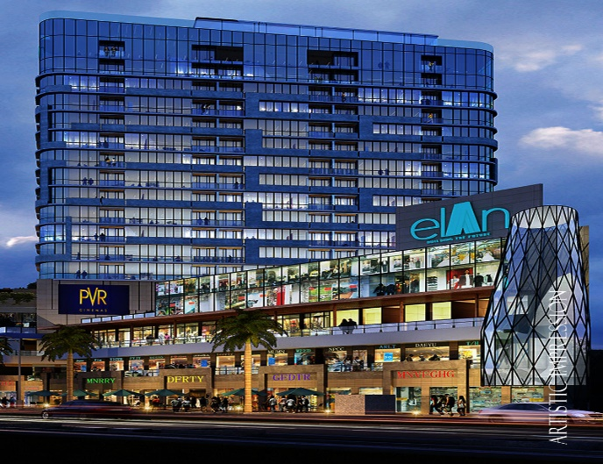

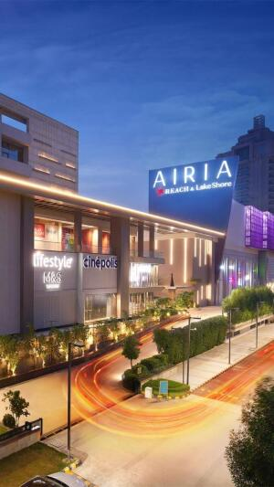
MALL Project Completed
Elan Miracle, Sec 84, Gurgaon.
Elan Mercado, Sec 80, Gurgaon.
Elan Town Centre, Sec 67, Gurgaon.
Reach Airia, Sec 68, Gurgaon..

Slide 6
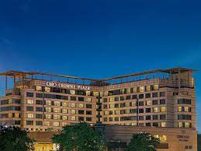
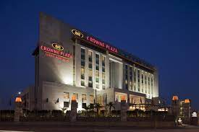


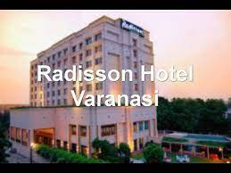

Our Proud Achievements In Hospitality Sector
Crown Plaza, Gurgaon
Crown Plaza, Okhla
Holiday INN Aerocity
Holiday INN Jaipur
Radison, Varanasi.
Mariot Westend, Rishikesh
Dr. BL Kapoor Memorail Hospital, Delhi.
Country Inn Suits Sahibabad

Slide 7
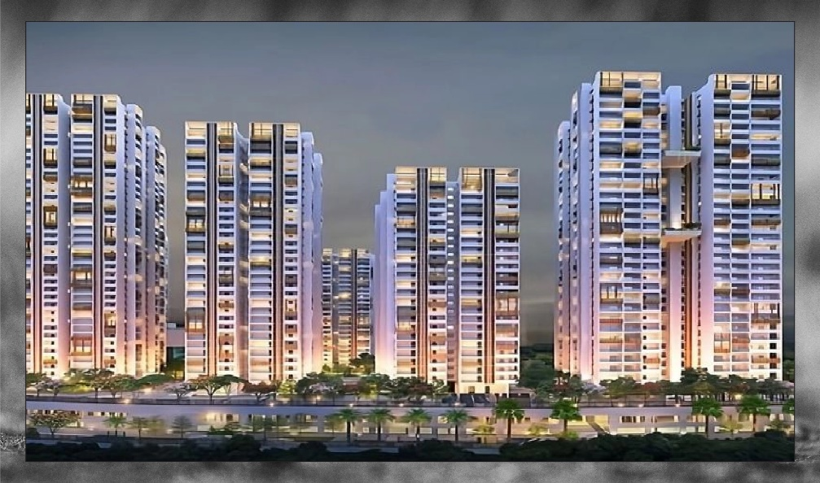
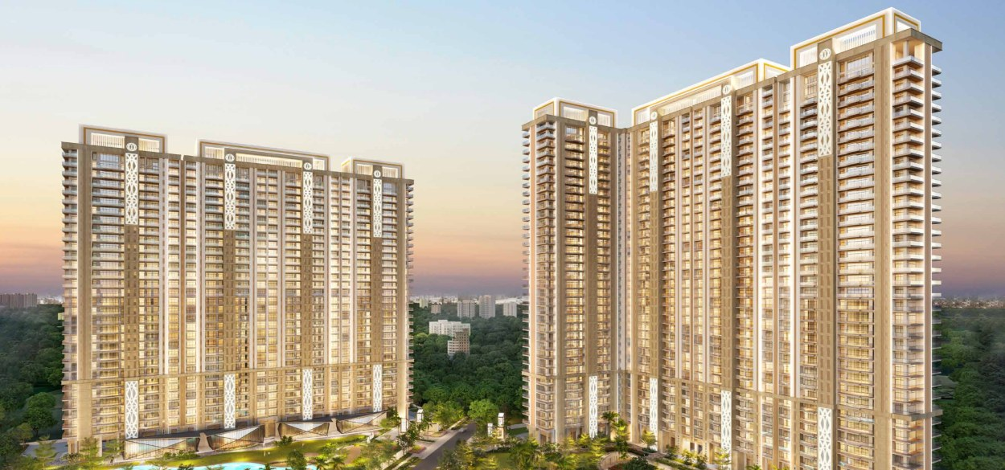
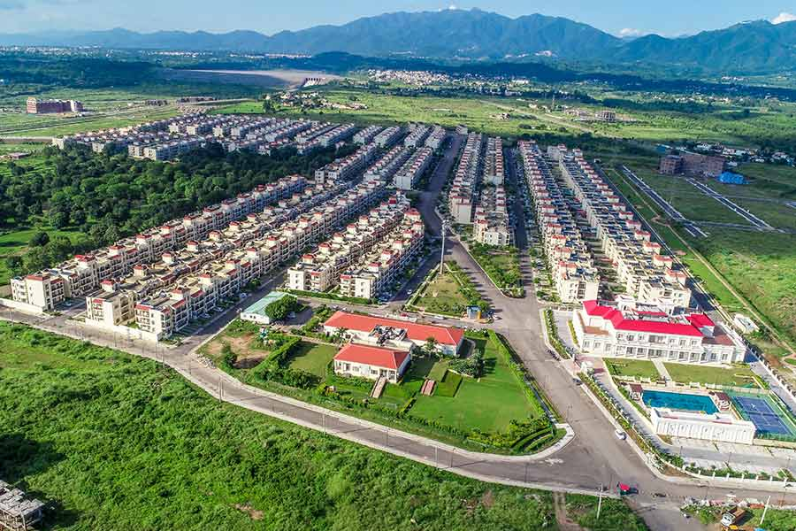
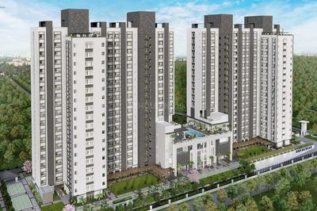
Project Ongoing
DLF Privana South, Sec 77, Gurgaon.
Whiteland Aspen, Sec 76, Gurgaon.
Pioneer Advait, Sec 50, Gurgaon.
DLF Valley Garden.

Slide 8
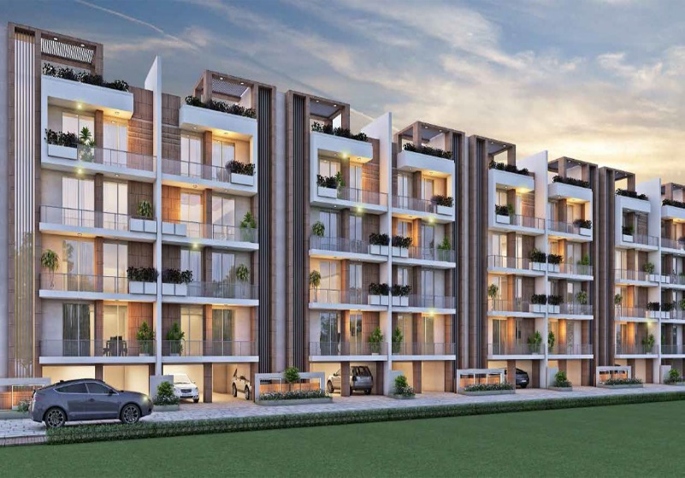


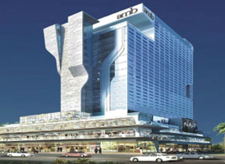
Project Ongoing
Smart world Gems, Sec 89, Gurgaon.
M3M Paragon, Sec 57, Gurgaon.
Whiteland Urban Cubes, SCO Plot, Sec 71, Gurgaon.
AMB Selfie Square, Sec 37D, Gurgaon..
.

Slide 9
PROJECT APPROACH
CASH FLOW
WORK SCHEDULE
MANPOWER PLANNING
ORGANIZATION CHART
SITE MOBILIZATION
DESIGN & VALUE ENGINEERING
SUBMISSION OF SHOP DRAWINGS.
OFFICE & STORE SETUP.
COMPLIANCES.

Slide 10
Organization Chart Project
Afzal Hasan
(Director)
C A
HR
Purchase
Design
Accountant
At office
Draft man
Project Co-ordinator
At Site
Project Incharge
Safety In charge
Store In charge
Billing Engineer
Supervisor
Supervisor
Electrician
Store Helper
Supervisor

Slide 11
SITE MOBILIZATION
MOBILIZATION AT SITE WITHIN 15 DAYS FROM ISSUE OF FORMAL LOI / WORK ORDER .
DRINKING WATER FACILITY .
ELECTRICITY AND WATER ARRANGMENT .
CAR POLICY, THIRD PARTY LIABILITY, WORK MEN COMPENSATION INSURANCE, ESIC / PF COMPLIANCE.
BOCW
LABOUR LICENSE

Slide 12
SOFTWARE
FOR PLUMBING & FIRE FIGHTING
FOR DRAWINGS : AutoCAD
BILLING & COMMUNICATION : Tally Prime & MS Office.

Slide 13
TYPICAL DRAWING & DOCUMENTS PROCESS FLOW CHART
Engineering Discipline
Tender / GFC Drawing Received Details from Client
Drawing No.
Drawing Title
Received From Client
Revision No.
Shop Drawings/ Documents Status
Shop Drawing submission
Drawing No.
Drawing Title
Consultants/Client
Comments / Approval Received from Consultant/ client
Drawings/ Documents Dates
Dates
Transmittal No.

Slide 14
QUALITY ASSURANCE PLAN PLUMBING (PART - I)
Mission Statement of :-
The Quality assurance activity, in order to be truly effective has to ensure a progressively improved and uniform quality of the finished work. Experience gained over years indicate that “process control” is essential in building construction to ensure that the work in different phases is executed in a manner pre-determined and laid down in specification. In order to achieve the above, the prerequisites cover among other things, an in built provision in the contract for a system of continuous check on quality by the field staff and the contractor for ensuring quality of work, availability of adequately manned and equipped agency for overseeing the quality aspects, and periodical appraisal of quality and a system of feedback for effecting possible improvements.
Quality Definition:-
Quality is the totality of features and characteristics of a product for service that bears on its ability to satisfy the projects functional requirements. The quality of output is always agreed upon between the supplier and the client (in project works, contractor and the department, respectively) and the quality objective is to achieve zero defects with the best quality of the project works. This is possible only by ensuring quality control at every stage during progress of construction. Quality is conformity to standards and requirements to achieve excellence. The following are some definition pertaining to quality and how to achieve it .

Slide 15
QUALITY ASSURANCE PLAN PLUMBING (PART - II)
Quality Control (QC) –
The operation techniques, or a system of maintaining standards by reviewing, checking, inspecting and testing.
Quality Assurance –
The planned and systematic actions and implementations necessary to provide adequate confidence that the work will satisfy quality requirements.
Compliance of Material Specification:-
Verifications of test certificates of material approved with Data sheet.
Inspection and verification of both quantity and quality with tender and P.O. specifications.
Physically checking the arrived materials visually for any damages and by instruments i.e. tape, scale, gauges etc. taking reference from the approved dimensional drawings.
Check completeness of Scope of Supply.
Inspection during and after installation of material:-
Vertical piping in Shaft
Make, Specification & Sizes of Material as per approved TDS/BOQ Specifications.
Material used for supports is as per BOQ/ Approved Technical specification.
Number of Supports has been provided as required/ as per instructions of Client Engineer.
Checked the installation of Vertical pipes in shaft & horizontal pipes at ceilings with proper alignment with proper fixing of supports/ clamps.
Checked for all horizontal UPVC toilet pipes are properly connected with shaft vertical riser line.
Checked all the joints are completed properly with appropriate jointing method & material.

Slide 16
QUALITY ASSURANCE PLAN PLUMBING (PART - III)
Internal Water Supply & drainage
Make, Specification & Sizes of Material as per approved TDS/ BOQ Specifications.
Checked that FFL Level has been provided before start of Internal Plumbing works.
Checked horizontal/ vertical dimensions all Plumbing points including water supply as well as drainage points are as per approved GFC drawings.
Checked of water supply pipe are properly fixed & required saddles/ clamping being provided with proper chase filling.
Checked that required slope in drainage Pipes has been provided.
Checked that insulation tube has been properly fixed with required supports in hot water supply pipe.
Checked all Toilet Water supply pipe in wall & ceiling are tested at pressure approved for testing & pressure ratings with time is being recorded.
Checked that proper chase filling in internal toilet with cement mortar has been done.
Checked the level and centre line of Cistern fixing & alignment/ distance of the same with respect to soil pipe fixed for WC Connection.
Checked Inlet connection to Cistern has been done.
Checked that plumbing points are properly plugged.

Slide 17
QUALITY ASSURANCE PLAN PLUMBING (PART - IV)
External Water Supply & Drainage
Make, Specification & Sizes of Material as per approved TDS/ BOQ Specifications.
Checked that Excavation of trench/ Manhole is properly done with proper dressing & required slope in accordance of Invert level & connection level. Checked that Location of Manhole, Catch Pit & GT is as per approved drawing/ setting out plan.
Checked that thickness and slope of bed PCC is per BOQ specifications.
Checked that proper Slope has been maintained in Drainage Pipes.
Checked that jointing of pipes has been done before hunching.
Check for thickness of pipe hunching has been maintained as per BOQ specifications.
Checked that repair of manhole has been done at both the ends of pipe with proper finish.
Check soil refilling above pipe, ramming & compacting up to FFL as per BOQ specifications and removal of surplus soil from designated area.

Slide 18
QUALITY ASSURANCE PLAN FIRE FIGHTING (PART – I)
Mission Statement :-
The Quality assurance activity, in order to be truly effective has to ensure a progressively improved and uniform quality of the finished work. Experience gained over years indicate that “process control” is essential in building construction to ensure that the work in different phases is executed in a manner pre-determined and laid down in specification. In order to achieve the above, the prerequisites cover among other things, an in built provision in the contract for a system of continuous check on quality by the field staff and the contractor for ensuring quality of work, availability of adequately manned and equipped agency for overseeing the quality aspects, and periodical appraisal of quality and a system of feedback for effecting possible improvements.
Quality Definition:-
Quality is the totality of features and characteristics of a product for service that bears on its ability to satisfy the projects functional requirements. The quality of output is always agreed upon between the supplier and the client (in project works, contractor and the department, respectively) and the quality objective is to achieve zero defects with the best quality of the project works. This is possible only by ensuring quality control at every stage during progress of construction. Quality is conformity to standards and requirements to achieve excellence. The following are some definition pertaining to quality and how to achieve it .

Slide 19
QUALITY ASSURANCE PLAN FIRE FIGHTING (PART – II)
Quality Control (QC) –
The operation techniques, or a system of maintaining standards by reviewing, checking, inspecting and testing.
Quality Assurance –
The planned and systematic actions, and implementations necessary to provide adequate confidence that the work will satisfy quality requirements.
Quality System (QS) –
A set of documented processes, which seek to provide satisfaction that the project outputs will fulfil all the requirements for which it is being planned. The quality system should fully incorporate the organization, human resources, materials, equipment, processes, inspections, testing and other parameters of the project. A key element of QS is the QA/ QC manual.
Quality Surveillance –
This normally covers two aspects. At the project level, a review is required to ensure that the quality practices are implemented and documented to ensure in relation to the quality system. At the contract package level, inspection and testing is required to ensure that the work executed meet the required quality standards.
Compliance of Material Specification:
Verifications of test certificates of material approved with Data sheet.
Inspection and verification of both quantity and quality with tender and P.O. specifications.
Physically checking the arrived materials visually for any damages and by instruments i.e. tape, scale, gauges etc. taking reference from the approved dimensional drawings.
Check completeness of Scope of Supply.

Slide 20
QUALITY ASSURANCE PLAN FIRE FIGHTING (PART – III)
Inspection during and after installation of material:
Compliance of work with Approved drawings, good engineering practices
Own/consultant/PMC/Client’s Check List to ensure quality of various erection activities during and after completion.
To ensure co-ordination with other services and agencies.
Pressure testing of piping, documentation duly signed by all concerned.
Quality of installation like –
Insure ‘V’ Grooved on Pipes.
Pipes shall be tested for thickness and weight as per specification and tender conditions.
Pressure testing of the pipes shall be done as per relevant CPWD general Specification for Plumbing & Fire Fighting works after installation welding etc. before commissioning of the system at 1.5 times of working pressure.
Straightness of support rods, angles, channels etc.
Linearity of pipes i.e. parallelism to each other & vertical alignment.
Pipe Support quality.
Pipe to be cleaned and clear of any residue dirt, foreign particles by long handled brush prior to installation.
The auto operation of all pumps shall be tested as per design sequence and at required pressure drop.
Alignment of pumps with proper alignment protocol which is to be vetted by concerned agencies.
The line diagram including schematics and operation logics will be made and displayed in fire pump room as well as control room.

Slide 21
QUALITY ASSURANCE PLAN FIRE FIGHTING (PART – IV)
Inspection before Commissioning
Physical verification of installation for correctness like –
Correct water piping connection of all System.
Checking Phase sequence at Pumps.
Correctness of alignment of Pumps.
Correct rotation of Pumps.
Flushing of pipe & system till the water coming out is declared to be transparent by the PMC/Client.

Slide 22
SAFETY COMPLIANCE
SAFETY COMPLIANCE:-
EHS POLICY
PPE- HELMET, SAFETY SHOES, WELDING GOOGLES, MASKS
SAFETY BELTS, BARRICADING TAPE
SCAFFOLDING
REGULAR TBT
REGULAR SAFETY MAN POWER INDUCTION
INDUSTRIAL SOCKET BOX
DRINKING WATER
SAFETY SIGNAGE
FIRE EXTINGUIGHERS
FIRST AID KIT

Slide 23
SAFETY NORMS ADOPTED
• Workmen at site will be covered under E.S.I., P.F., BOCW & TPL
Work Force at site will use safety helmets.
• Workmen working on electrical active lines will wear Electrically insulated gear.
• Workers working at height above 12 feet will use safety belts.
• Welders will use Welding glasses.
• Hand Gloves and Masks as per area of work.
• First Aid Boxes will be available at site office.

Slide 24
ENVIRONMENTAL PROTECTION NORMS
1) Collection & safe disposal of all the waste material like pieces of cable / wire, structure material & any other waste generated at our site construction activities & production units.
2) We will keep the total cleanliness in all areas of operations & will ensure that the complete repairs are carried out in case of any digging & modification of structure while carrying out our work.
3) We will keep all our tools and tackles at proper place before & after the work.
4) We will maintain an ethical & conductive work environment at all our work places.

Slide 25
Monthly EHS Reports to Client
Monthly man-hour details as specified in the Project EHS manual
Monthly accident / incident details as specified in the Project EHS manual
EHS committee details
Details of EHS training conducted in the month
EHS Inspection
EHS internal audit details like electrical audit etc.
Toolbox talks details
PPE details: Quantity purchased, issued to the workmen and stock available.
Barricade maintenance details
Health & Welfare activities
Safety walk conducted by Contractors’ Project Manager in the month
EHS Activities Planned for next month
Issue of Photo ID cards
Work Permit for General work, Hot Work, Height work & Night work etc.
Daily Check sheet for all Equipment's & Machinery.
Daily Check sheet for electrical panels & Dbs.

Slide 26
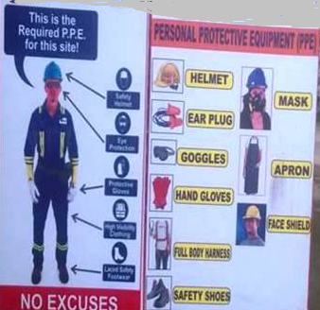
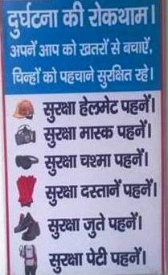
SAFETY SIGNAGE AT SITE

Slide 27
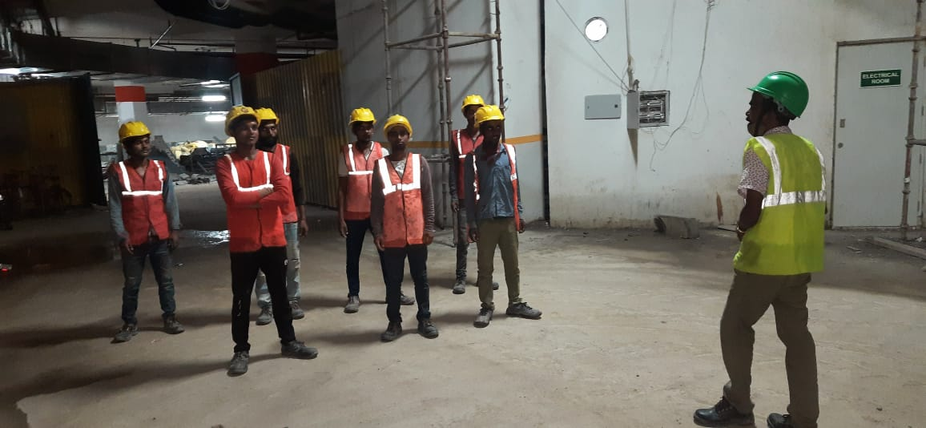
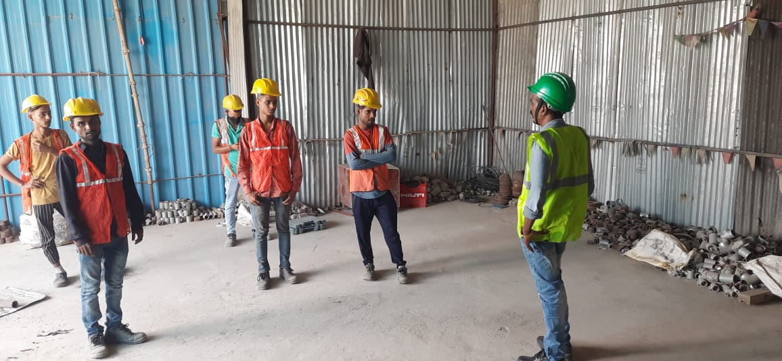
SAFETY TRANNING AT SITE

Slide 28
TESTING & COMMISIONING AT SITE PLUMBING & FIRE FIGHTING
Testing & Commissioning Method Statement For Fire Fighting Pumps
Below is a complete step wise Testing & Commissioning Method Statement For Fire Fighting Pumps. The purpose of this procedure is to define the step by step method to implement the correct practices for the testing, pre-commissioning & commissioning of “Fire Fighting Pumps” through the guidelines contained herein so as to ensure that the job execution complies with the project requirements and serves the intended function to satisfactory level.
This method applies for startup of pumps only not for a complete firefighting system which requires a separate detailed procedure for commissioning.
TOOLS / EQUIPMENTS
Portable Hand tools
Step Ladder
Measuring instruments (with valid calibration certificate) TESTING & COMMISSIONING PROCEDURE
Pre-commissioning Procedure for Fire Fighting Pumps
1. Ensure that the pump installation is complete and approved.
2. The civil defence approval shall be obtained prior to the pre-commissioning & commissioning of the Fire Fighting System.
3. Note the details of each motor such as make, model number, frame size, kW rating and RPM.
4. Check that the Fire Fighting piping network is complete with proper valves, drains, vents, strainers, pressure switches & instruments in place.
5. Ensure that the Fire Fighting network is hydraulically pressure tested and approved.
6. Ensure the pumps bearings are lubricated/greased as per manufacturer recommendation.
7. Ensure the pump shafts are rotated by hand freely.
8.Ensure that electrical power connections and earthing is proper.
9. Ensure that the field wiring is pre-tested for continuity and insulation resistance
10. Ensure that all the relevant valves are in open position. Pump discharge valve should be in closed position.
11. Check for free rotation of motor shaft by hand.

Slide 29
TESTING & COMMISIONING AT SITE PLUMBING & FIRE FIGHTING
Commissioning Procedure for Fire Fighting System
Ensure that all the pre-commissioning checks are carried out successfully.
Ensure the discharge valve is closed.
Ensure the pump & the pump suction is completely filled with water prior to starting the pump.
Start the pump and record shut-off head for low zone.
Slowly open the discharge valve of the low zone header & record the discharge head for 50% of the design flow. The discharge valve shall be slowly opened & the flow through the piping shall be checked in the flow meter for every rotation of the valve spindle until the flow is 50% of the design.
Similarly discharge head shall be measured for 100% & 150% of design flow.
Observe leakage from stuffing boxes and adjust the flow for lubrication of packing.
Repeat steps 2 & 3 for the high zone & record the values.
Check pumps for overheating by physically touching by hand.
Check for any vibration/noise.
Check current, voltage & rpm of the motor & record the values.
Calculate the actual pump performance and plot actual performance curve For both low zone & high zone.
Check the interface with BMS & fire alarm system.
The wiring diagram of pump controls & schematic piping shall be displayed near or inside the control panel.
Testing & Commissioning Procedure for Jockey Pumps – Fire Fighting System
Below is the procedure for Testing & Commissioning of Jockey Pumps for the Fire Fighting System
Pre Commissioning Procedure for Fire Fighting Jockey Pumps
Ensure that the pump installation is complete and mechanical completion is approved.
Ensure that no damage occurs between mechanical completion & pre commissioning.
Repair all damages to the equipment paint finish.
Ensure that the pumps are identified location wise and service wise.
Ensure that the system is cleaned internally & externally.
Check again the alignment of pump and driver shaft and comply with manufacturer instructions.
Note the details of each motor such as make, model number, frame size, kW rating and RPM.
Check that the Fire Fighting piping network is complete with proper valves, drains, vents, strainers, pressure switches & instruments in place.

Slide 30
TESTING & COMMISIONING AT SITE PLUMBING & FIRE FIGHTING
Ensure that the Fire Fighting network is hydraulically pressure tested and approved.
Ensure the pumps bearings are lubricated/greased as per manufacturer recommendation.
Ensure the pump shafts are rotated by hand freely.
Ensure that electrical power connections with control panel, pressure switch & earthing is proper.
Ensure that the field wiring is pre-tested for continuity and insulation resistance.
Ensure that all the relevant valves are in open position.
Check the rotation of motor shaft by hand.
Check identification and labeling for equipment.
Commissioning Procedure for Jockey Pumps
Ensure that all the pre-commissioning checks are carried out successfully.
Open the suction valve & allow water to flow into the pump
Start the pump and record the discharge pressure.
Observe leakage from stuffing boxes and adjust the flow for lubrication of packing.
Check pumps for overheating physically by hand.
Check for any undue vibration/noise.
Check current, voltage & rpm of the motor & record the values.
Plot the pump actual performance curve.
The enclosed manufacturer’s instructions shall be fully followed.
PRE-COMMISSIONING & COMMISSIONING METHOD STATEMENT FOR FIRE HOSE REEL DRUM & FIRE HOSE REEL
TESTING, PRE COMMISSIONING & COMMISSIONING PROCEDURE METHOD STATEMENT FOR FIRE HOSE REEL DRUM & FIRE HOSE REEL.
Pre-commissioning Procedure for Fire Hose Reel Drum & Fire Hose Reel
Ensure that the Hose Reel Drum & Hose Reel installation is complete and mechanical completion is approved.
Ensure that all drawings are approved by the civil defense authority.
Ensure that no damage has occurred between mechanical completions & pre-commissioning.
Repair all damages to the equipment paint finish.
Check that the Fire Fighting piping network is complete with proper valves, drains, vents, strainers, pressure reducing valves & instruments in place.

Slide 31
TESTING & COMMISIONING AT SITE PLUMBING & FIRE FIGHTING
Ensure that the Fire Fighting network is pressure tested and approved.
Ensure that future provision connection to the hose reels are installed and plugged suitably.
Ensure that the Fire cabinets & hose reels are installed in line with approved shop drawings & relevant method statement.
Ensure fire extinguishers are installed as per approved shop drawings.
Ensure that the fire cabinet door can be fully opened.
Ensure that the fire pumps are commissioned & the system is under pressure.
Ensure that the supervisory control valve for the fire hose cabinet is installed & electrically connected to fire alarm system.
Ensure that all valves are properly tagged & identified
Commissioning Procedure for Fire Hose Reel Drum & Fire Hose Reel
Ensure that all the pre-commissioning checks are carried out successfully.
Open the supervisory isolation valve for the fire hose cabinet & allow the water to flow into landing valve & hose reel.
Hose Reel
Pull out the hose from the hose reel to a length of approximately 3 meters & ensure that the automatic valve opens & the fire alarm signal is generated.
Ensure that the complete length of hose will open in all directions only by pulling the nozzle without even touching the hose reel.
Adjust the nozzle to set the required throw / flow of water.
Check for any leakage in the hose reel connections.
Check the pressure in the PRV downstream which should be 65 psi.
Hose Reel Drum
Pull the hose from the hose Reel Drum.
Open the landing valve & check the water flow from the nozzle.
Check if the fire alarm signal is generated.
Check for any leakage in the hose connection / pipe joints.
.

Slide 32
Communication Protocol
S.No. | Name | Designation | Phone No. | Mail ID
1 | Mr. AFZAL HASAN | Proprietor | 9811138210 | Uew_hasan1@yahoo.co.in
2. | Mr Shamim Ahmad | Project Co-ordinator | 9811970626 | Shamim_ues@yahoo.com

Slide 33
Escalation Matrix
AFZAL HASAN
(Director)
3rd Level
2nd Level
PLANNING
& COORDINATION
Mr Shamim Ahmad (Director Project)
At Office
X
At Site
1st Level
MANAGER

Slide 34
THANK YOU

